Slide 1

Introduction to Performance Testing
Eyad Mohamed Afifi
Information Technology Institute Track Of Software Testing and Quality Assurance

Slide 2
Agenda:-
What is Performance Testing
Why Performance Testing
When Performance Testing
Benefits of Performance Testing
How we conduct Performance Testing
Performance Testing Types
Performance Life Cycle
Performance Testing Tools

Slide 3
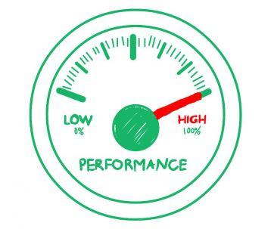
What is Performance Testing:
Performance testing is in general, a non- functional testing practice performed to determine how a system performs in terms of responsiveness and stability under a particular workload
It can also serve to investigate, measure, validate or verify other quality attributes of the system, such as scalability, reliability and resource usage.

Slide 4
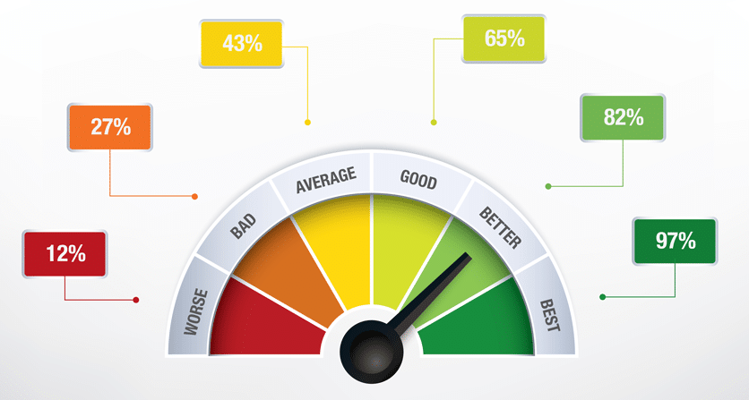
Why Performance Testing:
In general performance testing is conducted to validate non-functional performance requirements for the software.
To ensure that the system meets performance expectations such as response time, throughput etc.
In some cases, performance test is executed to replicate performance issues.
And in other cases, it compare two systems to find which performs better. Or it can measure what part of the system or workload causes the system to perform badly.

Slide 5
Benefits of Performance Testing
Quality
Identifies problems early before they become costly to resolve.
Produces better quality, more scalable code.
Prevents revenue and credibility loss.
Enables intelligent planning for future expansion.
Poor Performance Impacts
Customers
Revenue
Productivity

Slide 6
How we conduct Performance Testing
Performance test is commonly conducted using a performance testing tool.
Most of the tools are based upon capturing/replicating the requests/calls to the software and then running it with multiple threads (virtual users). Additionally, the performance testing tool capture the performance metrics of the software.

Slide 7
Performance Testing Types
Load Testing
Stress Testing
Endurance Testing
Spike Testing
Volume Testing
Notes:
Endurance Testing: For example, in software testing, a system may behave exactly as expected when tested for 1 hour but when the same system is tested for 3 hours, problems such as memory leaks cause the system to fail or behave randomly.

Slide 8
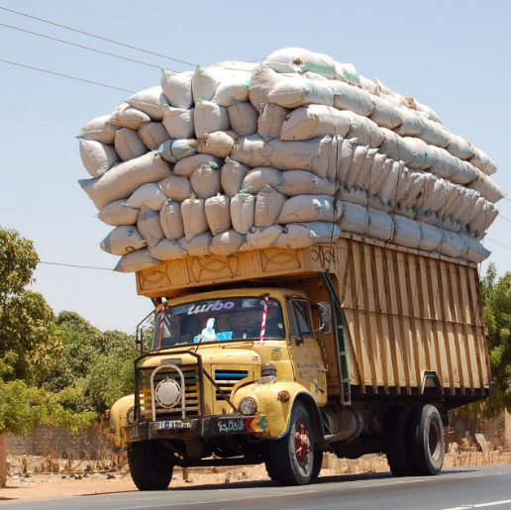
Load Testing
Load testing involves simulating real-life user load for the target application.
It helps you determine how your application behaves when multiple users hits it simultaneously.
The goal is to understand the behavior of the application under a specific expected load.

Slide 9

Stress Testing
Stress testing involves testing beyond normal capacity, often to a breaking point, in order to observe the results .
The goal is to ensure the software does not crash in conditions of insufficient computational resources (such as memory or disk space).

Slide 10
Endurance Testing
Endurance testing involves testing a system with a significant load extended over a significant period, to discover how the system behaves under sustained use.

Slide 11

Volume Testing
Volume testing refers to testing a software application or the product with a certain amount of data to determine system performance with increasing volumes of data in the database.

Slide 12
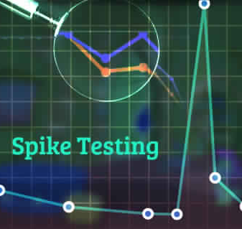
Spike Testing
Spike testing help us to determine whether the application can handle or not significant changes in the load. Is performed by sudden increase/decrease in load and observing the behavior of the application.

Slide 13
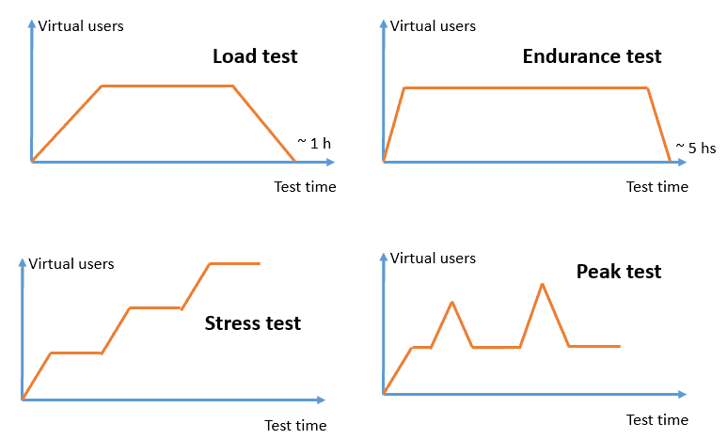
Performance Testing Types

Slide 14
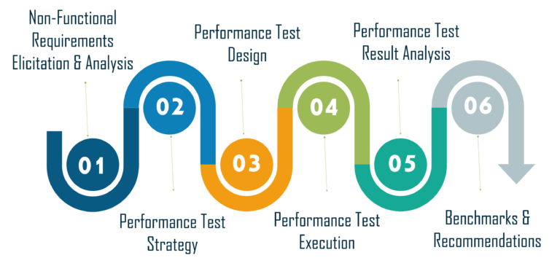
Performance Life Cycle

Slide 15
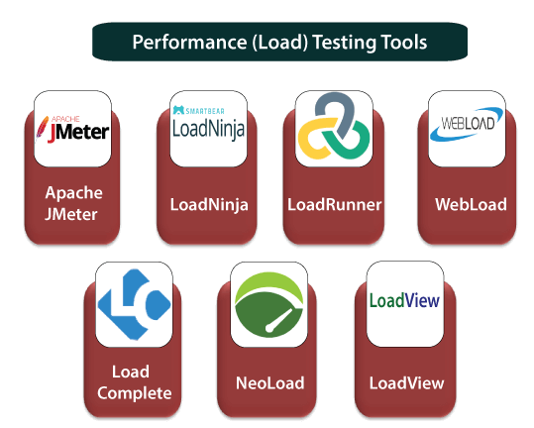
Performance Testing Tools

Slide 16
Demo

Slide 17
Conclusion
Performance testing helps to check the behavior of an application across various situations. A system can work effectively with a particular number of concurrent users but might get dysfunctional with additional thousands during peak traffic.
Engage customers with better website speed
Most importantly, the faster the website, the more revenue it will generate
Resolve glitches before it goes to the market
Bring stability and dependability within an application
Build responsiveness of an application

Slide 18
Resources
https://www.guru99.com/performance-testing.html
https://www.testingxperts.com/blog/performance-testing-guide/
https://guides.blazemeter.com/g/the-definitive-guide-to-performance-testing/22133
https://www.edureka.co/blog/performance-testing-tools/
https://u-tor.com/topic/what-is-performance-testing

Slide 19
Thanks

